Slide 1
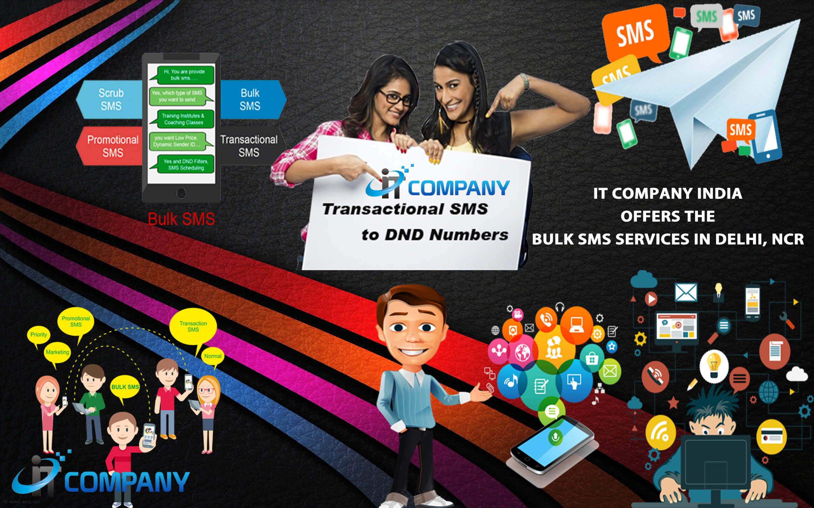
Bulk SMS :- Bulk SMS Marketing has a very high open rate

Slide 2
Bulk SMS- This is no new business technique from the traditional marketing era. This concept has been introduced since long and is considered to be the most effective and fastest reaching methodology to the potential customers. SofiDial InfoTech lets you create your platform for utilizing the benefits of these services and also does this on your behalf for your brand promotion and an impactful presence on online portals.
Sofidial ensures exhaustive computerized databases of carrier-wise subscriber further sub-categorized according to various parameters such as social demographics, economic parameters, city-wise, rural subscribers, gender based, personal and business numbers.
BULK SMS as the name goes gets you with some relevant data which can be your own creation or we get the analyzed data, with the aim to get your brand and business prospectus reach the targeted audience well on time and converts the sales into even higher peaks. It is a platform where the businessmen or organizations send “bulk messaging” to one or multiple receivers via software platforms. Bulk SMS can scale up to millions on both national and international broadcastings.
Visit Us :-http://www.sofidial.com/Bulk-SMS-Service-Provider

